Slide 1
Continuous Transparency and Reproducibility in Academic Publications
Lars Vilhuber
Cornell University
2023-04-27
The opinions expressed in this talk are solely the authors, and do not represent the views of the U.S. Census Bureau, the American Economic Association, or any of the funding agencies.
© Lars Vilhuber .
Notes:
I am going to
Very briefly describe the background we are coming from
Make note of the various elements of progress (and the broader picture) of open science
Describe some of the ongoing challenges
Provide some guidance based on the lessons learned in the past year

Slide 2
Transparency and reproducibility of scientific publications does not stop at publication

Slide 3
Context

Slide 4

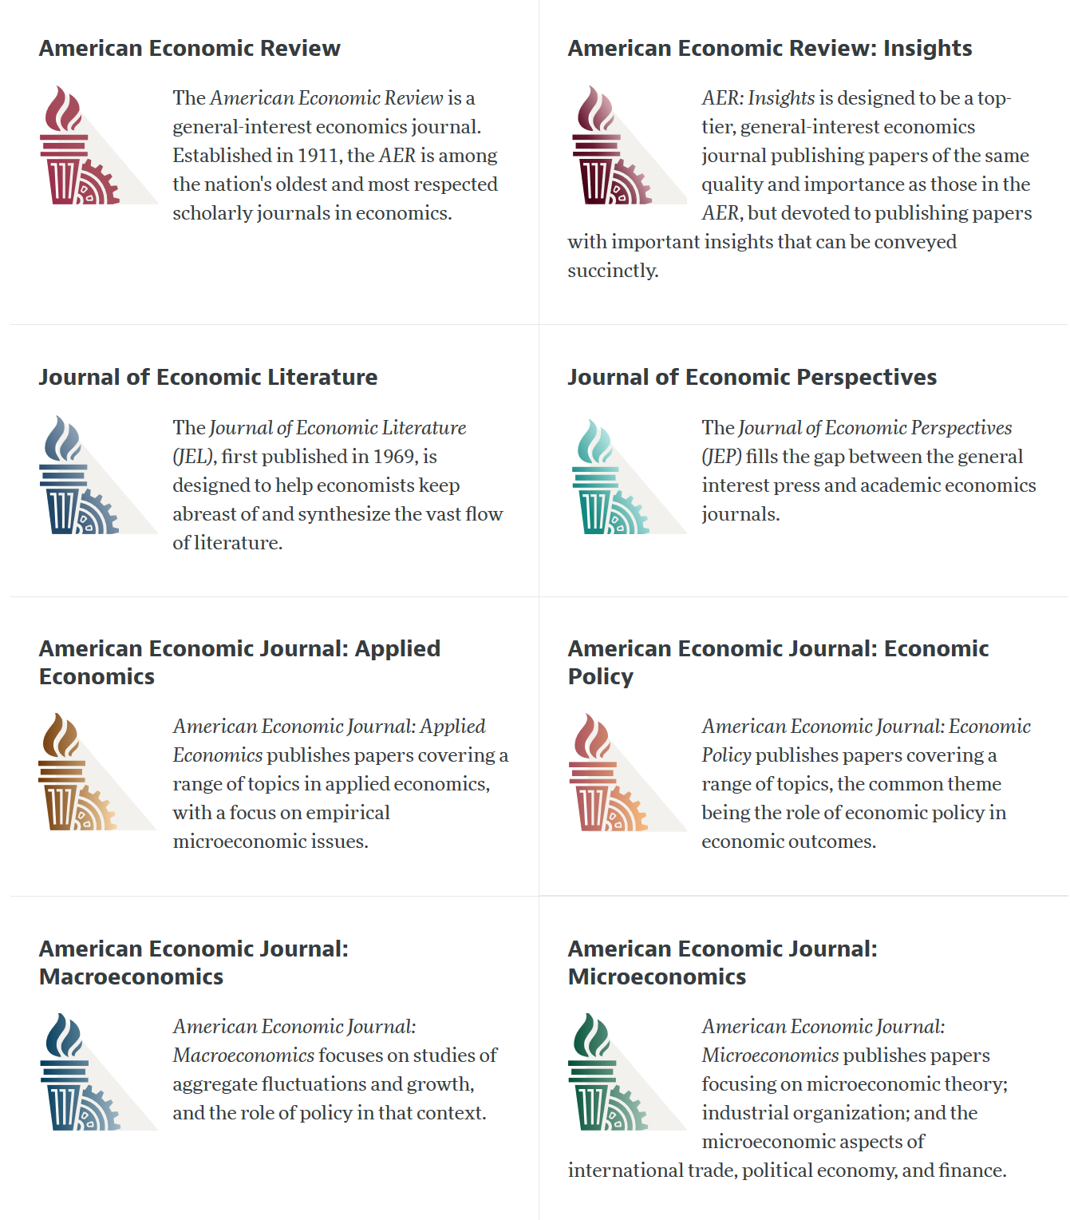

Slide 5
AEA Data & Code Availability Policy (2019)
It is the policy of the American Economic Association to publish papers only if the data used in the analysis are clearly and precisely documented and access to the data and code is clearly and precisely documented and is non-exclusive to the authors.
Authors of accepted papers that contain empirical work, simulations, or experimental work must provide, prior to acceptance, the data, programs, and other details of the computations sufficient to permit replication, as well as information about access to data and programs.

Slide 6
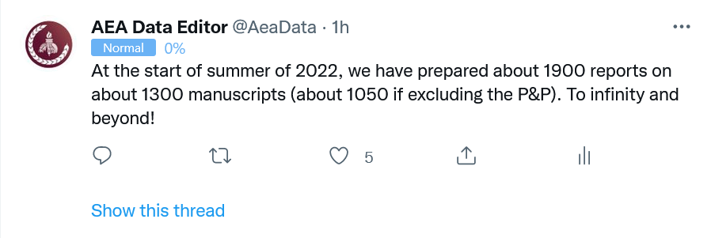
Reproducibility is assessed
Since July 16, 2019, the AEA Data Editor team has conducted reproducibility assessments
for 1663 manuscripts (1369 full papers, 293 P&P) as of this morning

Slide 7
Defining “reproducible research”
“Reproducibility” refers to the ability of a researcher to duplicate the results of a prior study using the same materials and procedures as were used by the original investigator.
Bollen et al. 2015. “Social, Behavioral, and Economic Sciences Perspectives on Robust and Reliable Science.” National Science Foundation.https://www.nsf.gov/sbe/AC_Materials/SBE_Robust_and_Reliable_Research_Report.pdf.

Slide 8
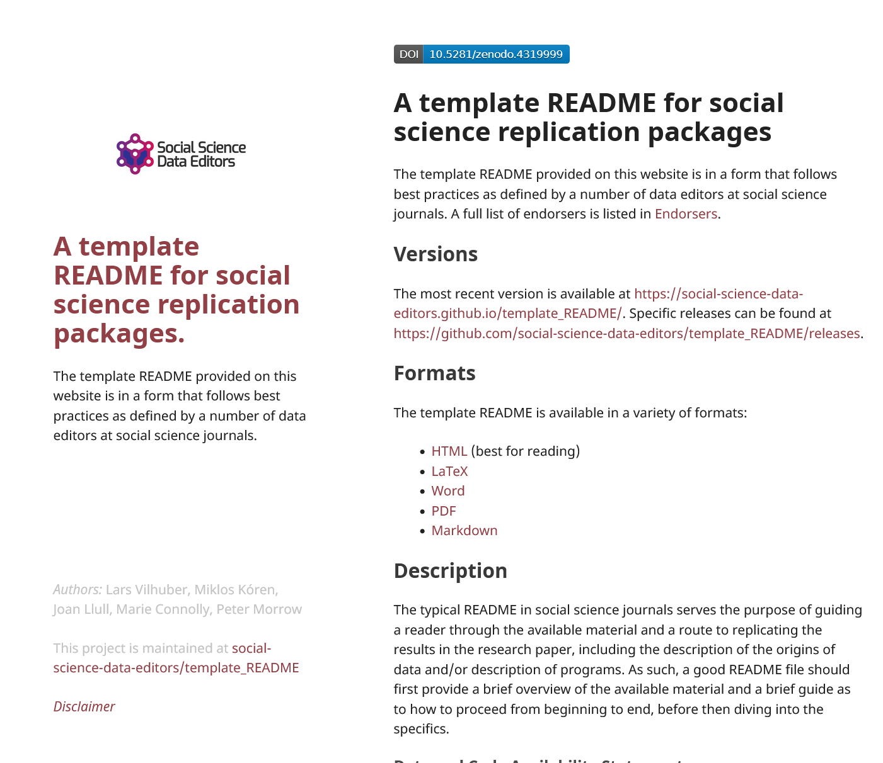
What do we check?
How can somebody access the data?
How can somebody assemble the computational resources?
How can somebody obtain the figures and tables in the paper?
How long will that take?

Slide 9
Guidelines? Template README
https://doi.org/10.5281/zenodo.4319999

Slide 10
Computational empathy

Slide 11
Computational empathy
Focal reader: your next RA in 4 years
Interaction: you hand them your README, but don’t have time to go through all the details…
Budget constraint: It shouldn’t take too many RA hours
Time constraint: It shouldn’t take more than 1 week to “get it”

Slide 12
Research compendium

Slide 13
Research compendium
In the words of the slogan popularized by Buckheit and Donoho (1995),
“a scientific publication is [...] merely advertising of the scholarship: [...] the complete software development environment and the complete set of instructions which generated the figures.”

Slide 14
Research compendium
Article
Data
Statistical theory
Computational environment
Computer code

Slide 15
Partial research compendium is not robust
Article
Statistical theory

Slide 16
Research compendium

Slide 17
Research compendium

Slide 18
Do we have all the pieces?

Slide 19
Does code + data + compute create output?

Slide 20
Data provenance is important
?

Slide 21

Data access is important
?
Notes:
Person icon by Valerie Lamm under CC (Noun Project)

Slide 22







Data access
Public-use and shared confidential data

Slide 23
Correctness of code is important
? =

Slide 24
Is the computational environment completely defined?
Stata 14 MacOS 11.2 + 10 packages as of 2014

Slide 25
Is the computational environment completely defined?
R 3.6.2 Ubuntu 14.4 + gazillion libraries as of 2014

Slide 26
Is the computational environment completely defined?
Julia 1.4 + packages Rocky OS 9 + 250 Nvidia GPUs 8GB

Slide 27
Computational empathy
= “pity the poor replicator”

Slide 28


Slide 29
Computational empathy
= transparency

Slide 30
Monitoring
transparency

Slide 31
Journals check different things
AEA: after acceptance, is code complete, is data cited, does code run (if data accessible)
AJPS: after acceptance, is data documented, is code complete, does code run (if data accessible)?
CJE: after acceptance, is package plausibly complete?
Astrophysics: are data properly cited, are interactive graphics also accessible, is data standardized?

Slide 32
Monitoring
transparency

Slide 33
Journals are not the end…
Reproducibility and replicability is checked in graduate class work (even in undergraduate!)
Replication Games!
Articles build on the foundations laid by others
Rely on previous findings
Question and recompute previous findings

Slide 34
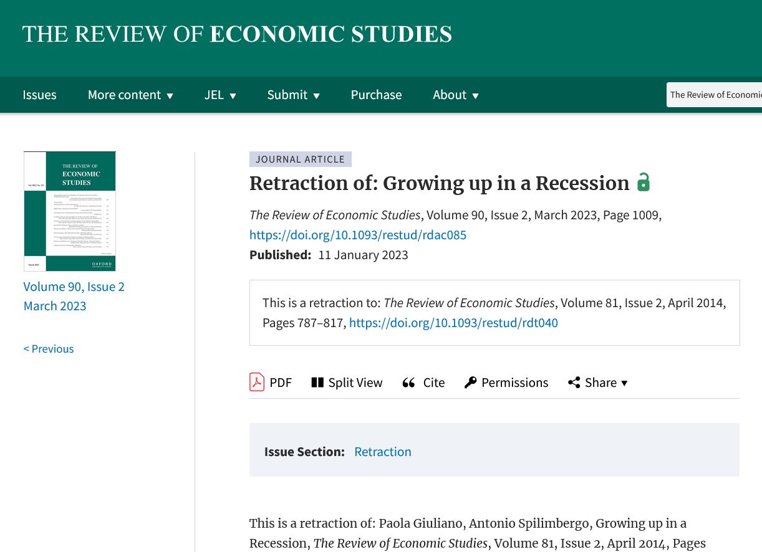
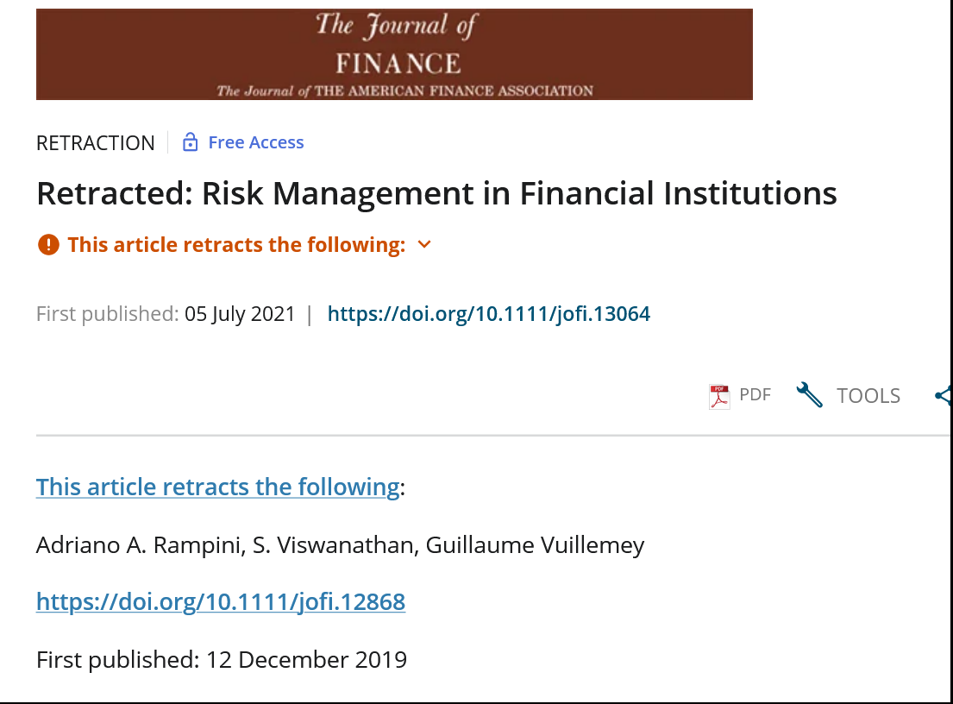
Painful when it fails

Slide 35
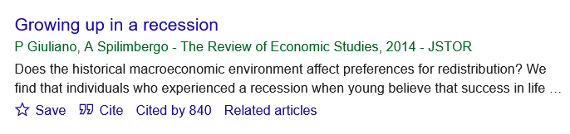
Correction of the academic record

Slide 36
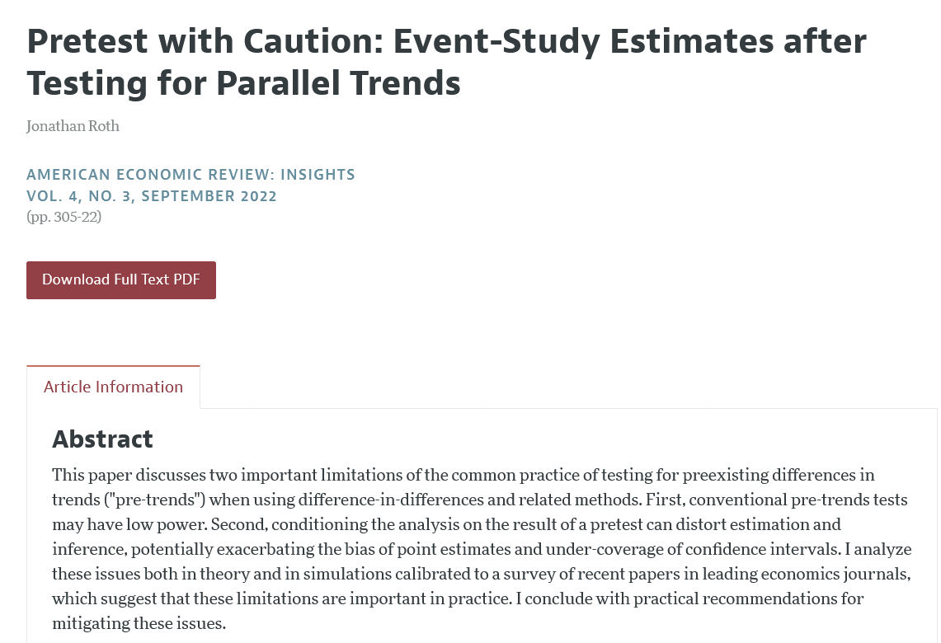
Powerful when it works

Slide 37
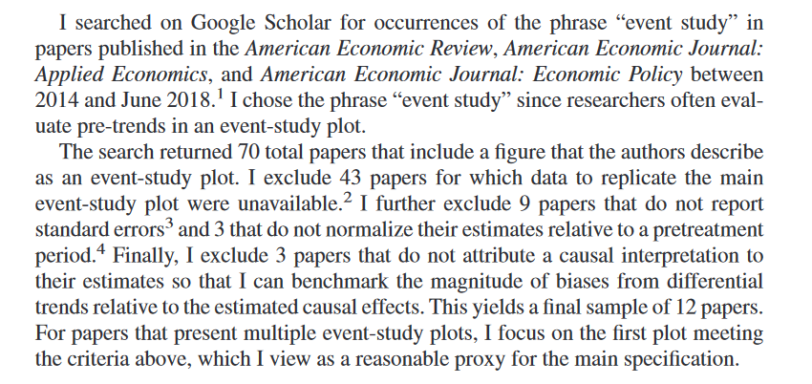
Availability key

Slide 38
Roth (2022) re-computes papers
Takes 12 papers with accessible papers
Re-runs the analysis for each of them, adding his special twist (in this case, looking at the power of pre-trend tests)
Not possible as meta-analysis: requires access to code and data

Slide 39
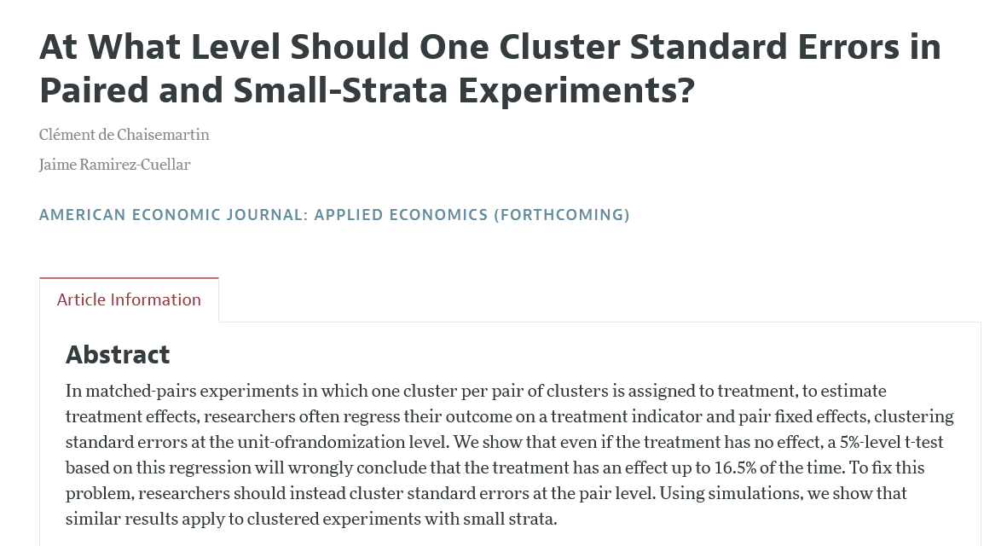
Similarly: de Chaisemartin + Ramirez-Cuellar (forthcoming, AEJ:Applied)

Slide 40
Do we have all the pieces?

Slide 41
Why

Slide 42

Replication continuum
https://doi.org/10.17226/25303
08
Reproducibility
Narrow Replication (Pesaran 2003)
Pure Replication (Hamermesh 2007)
Verification (Clemens 2015)

Slide 43
Replication continuum
Same data | Same code | Same methods | Same context
08
Reproducibility
Narrow Replication (Pesaran 2003)
Pure Replication (Hamermesh 2007)
Verification (Clemens 2015)

Slide 44
Replication continuum
08
08
Reproducibility
Replicability
Narrow Replication (Pesaran 2003)
Pure Replication (Hamermesh 2007)
Verification (Clemens 2015)
Wide Replication (Pesaran 2003)
Statistical Replication (Hamermesh 2007)
Reproduction/Reanalysis (Clemens 2015)

Slide 45
Replication continuum
Same data | Different code | Same methods | Same context
 | or software
08
08
Reproducibility
Replicability
Narrow Replication (Pesaran 2003)
Pure Replication (Hamermesh 2007)
Verification (Clemens 2015)
Wide Replication (Pesaran 2003)
Statistical Replication (Hamermesh 2007)
Reproduction/Reanalysis (Clemens 2015)

Slide 46
Replication continuum
New data | Same code | Same methods | Same context
collection
08
08
Reproducibility
Replicability
Narrow Replication (Pesaran 2003)
Pure Replication (Hamermesh 2007)
Verification (Clemens 2015)
Wide Replication (Pesaran 2003)
Statistical Replication (Hamermesh 2007)
Reproduction/Reanalysis (Clemens 2015)

Slide 47
Replication continuum
08
08
08
Reproducibility
Replicability
Generalizability
Narrow Replication (Pesaran 2003)
Pure Replication (Hamermesh 2007)
Verification (Clemens 2015)
Wide Replication (Pesaran 2003)
Statistical Replication (Hamermesh 2007)
Reproduction/Reanalysis (Clemens 2015)
Wider Replication (Pesaran 2003)
Scientific Replication (Hamermesh 2007)
Reanalysis/Robustness (Clemens 2015)

Slide 48
Replication continuum
Different data | Different code | Different | Different
 | or software | methods | context or
 |  |  | country
08
08
08
Reproducibility
Replicability
Generalizability
Narrow Replication (Pesaran 2003)
Pure Replication (Hamermesh 2007)
Verification (Clemens 2015)
Wide Replication (Pesaran 2003)
Statistical Replication (Hamermesh 2007)
Reproduction/Reanalysis (Clemens 2015)
Wider Replication (Pesaran 2003)
Scientific Replication (Hamermesh 2007)
Reanalysis/Robustness (Clemens 2015)

Slide 49
Tools

Slide 50
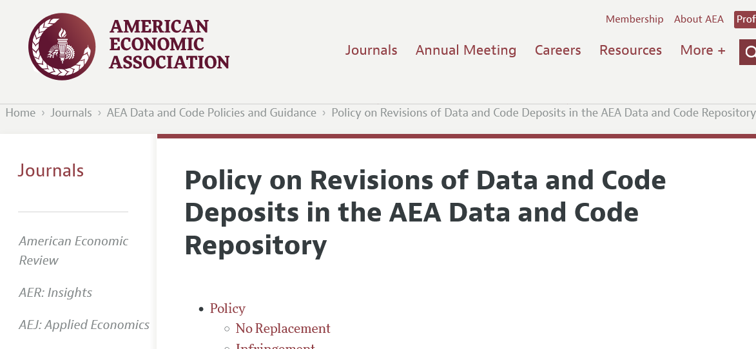
Continuous updating of replication packages
AEA policy allows for revisions of packages after publication
The initial package remains the “version of record”
Additional versions are linked

Slide 51
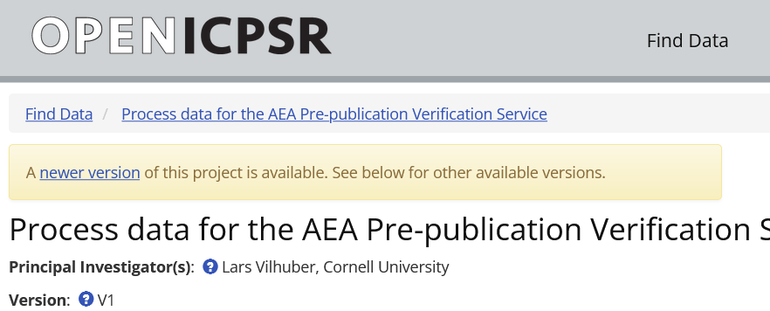
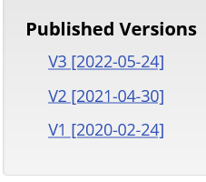
Continuous updating of replication packages
AEA policy allows for revisions of packages after publication
The initial package remains the “version of record”
Additional versions are linked

Slide 52
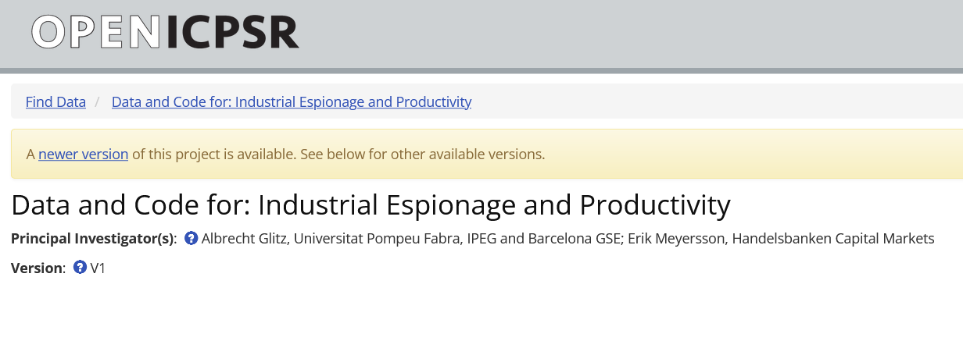
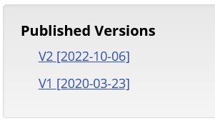

Continuous updating of replication packages
Data Editor monitors and responds to inquiries
About 3% of yearly activity are revisions

Slide 53
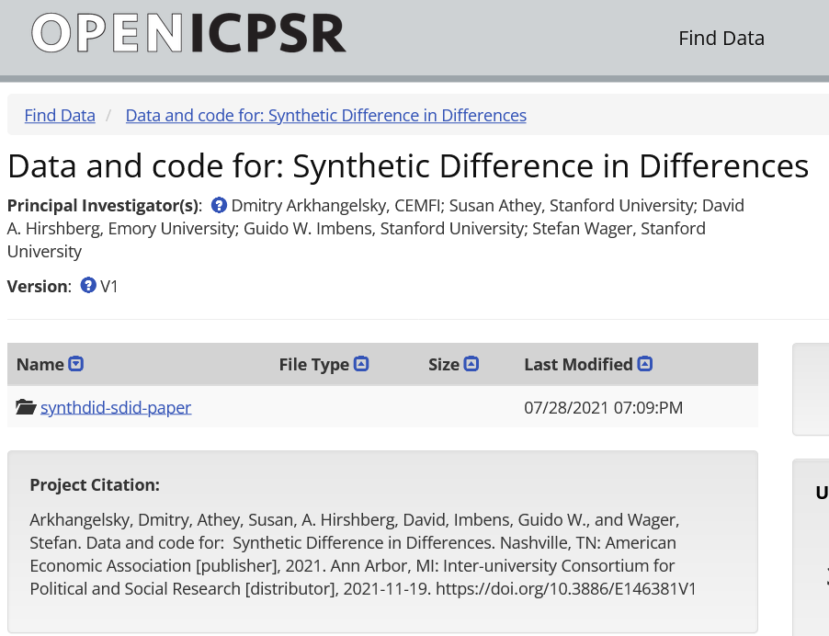
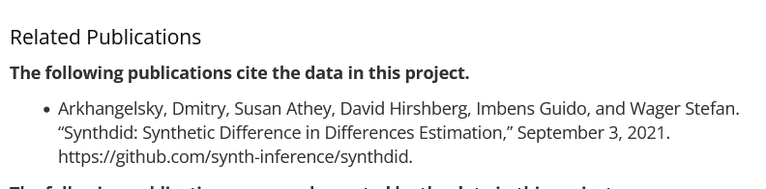
Linking to private sharing sites
Links to Github repositories
NOTE: Github.com is NOT an archive!
Links to source websites
Added as part of a “related publication” taxonomy

Slide 54
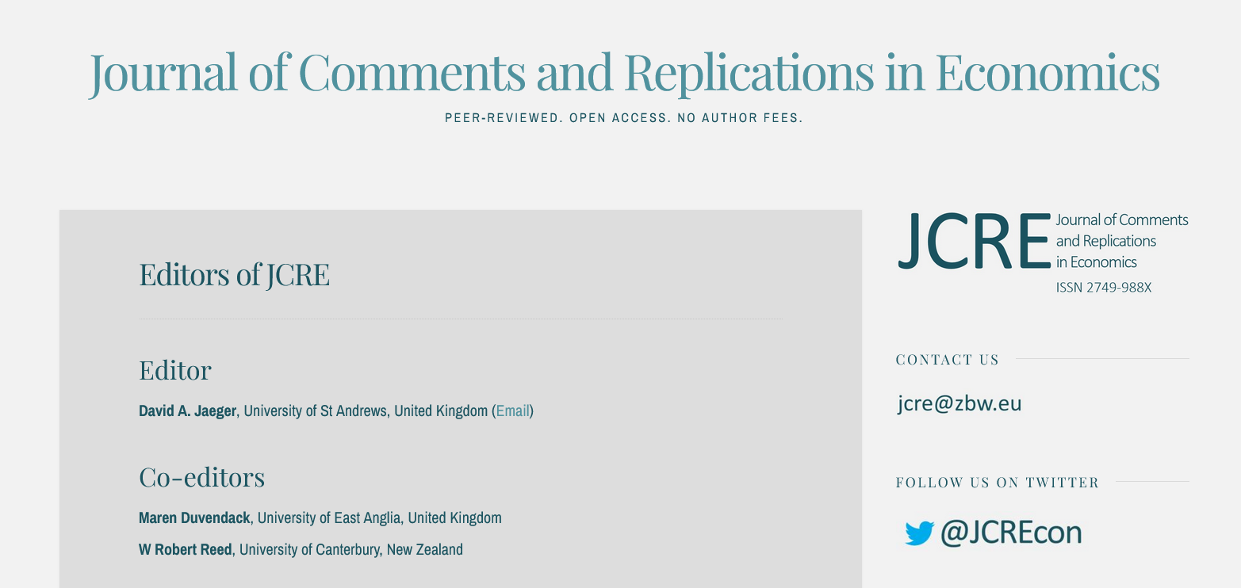


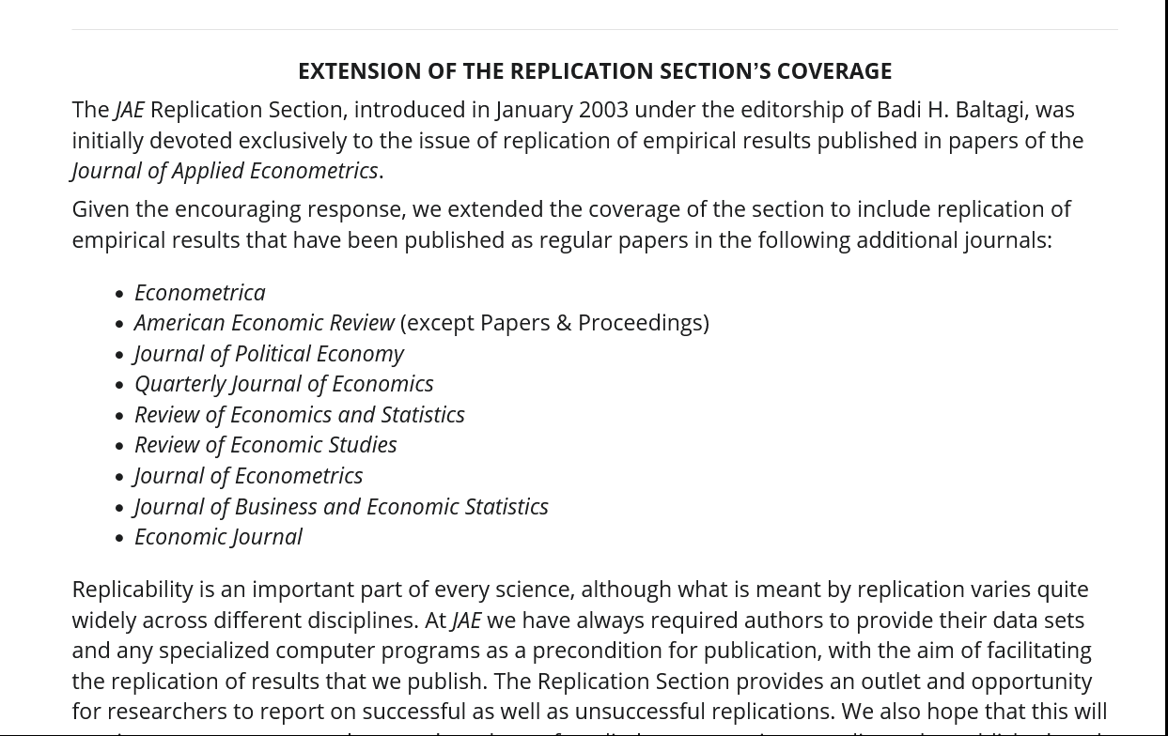
Special journals
Journal of Comments and Replications in Economics (JCRE)
Journal of Applied Econometrics
Research & Politics

Slide 55
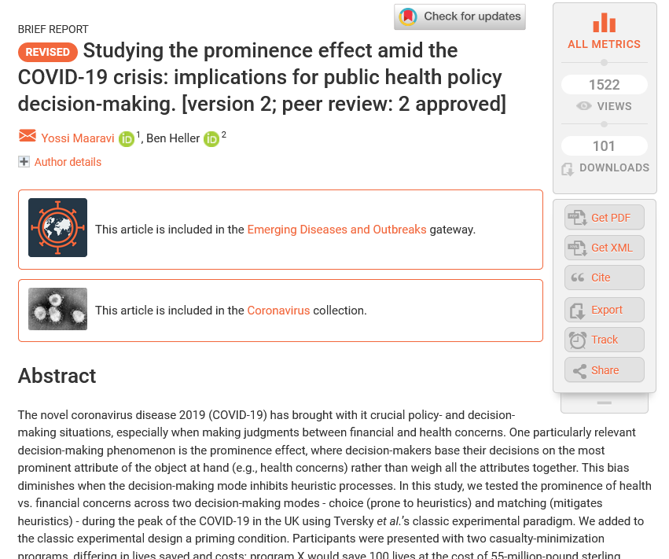
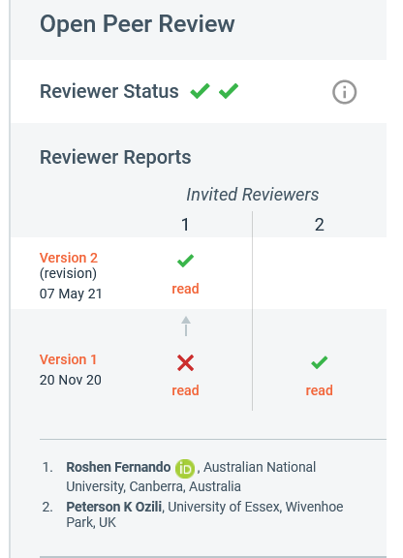
New types of journals?

Slide 56
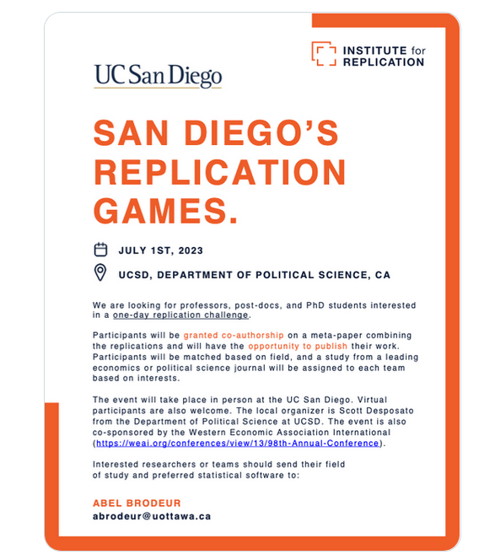


Generating findings

Slide 57
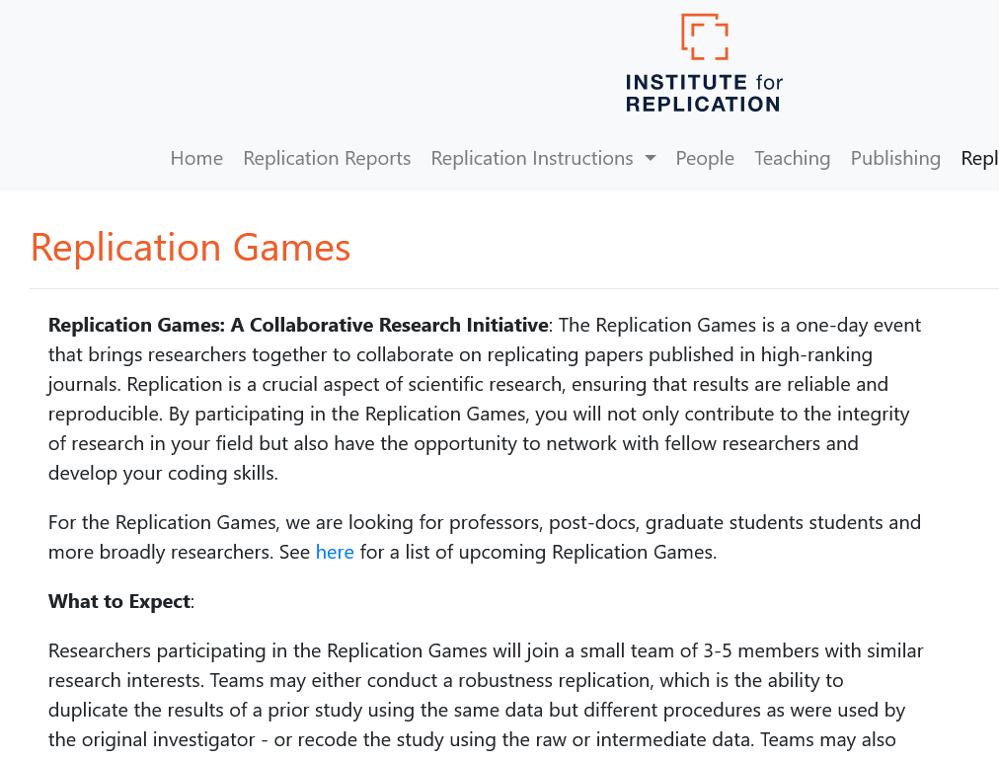
Replication games, challenges, etc.
https://i4replication.org/description.html
“Hackathon” for data
70+ people in multiple teams, not just econ

Slide 58
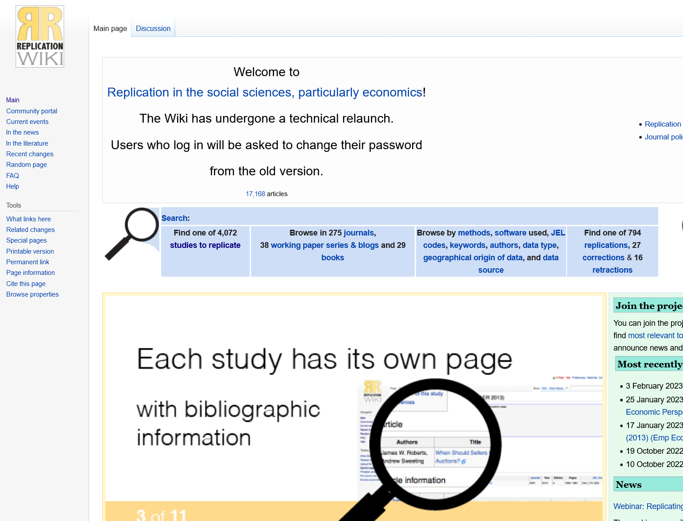
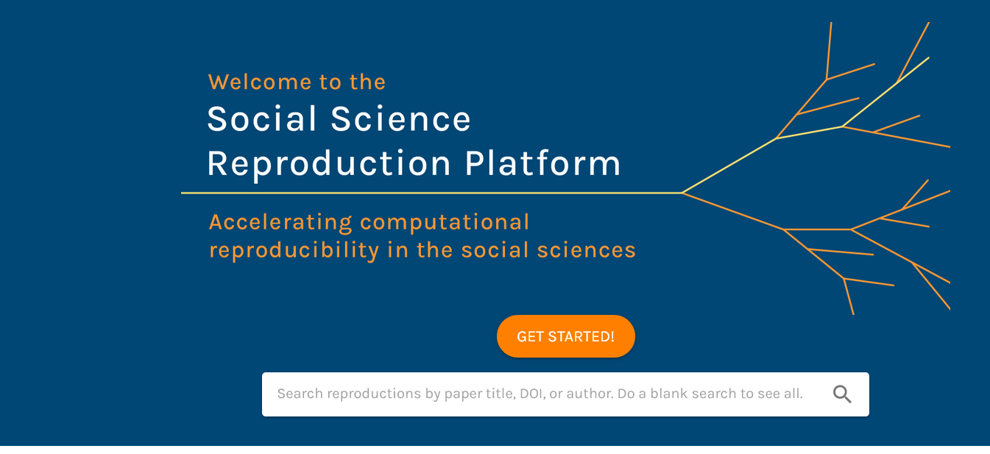
Classwork, but where to go?

Slide 59
Pushing the boundaries

Slide 60
Data
Research finding
Software

Slide 61
Data
Analysis data
Analysis code
Software

Slide 62
Data
Good replication package
Analysis data
Analysis code
Software

Slide 63
Data
Good replication package
Analysis data
Analysis code
Software

Slide 64
Data
Secondary data
Analysis data
Analysis code
Data cleaning code
Software

Slide 65
Data
Better replication package
Secondary data
Analysis data
Analysis code
Data cleaning code
Software

Slide 66
Data
Ipums
Author-created survey
Data provider
Author-obtained firm data
Census Bureau
Secondary data
Analysis data
Software provider
Analysis code
Data cleaning code
Software

Slide 67
Data
Data provider
Secondary data
Stata
Analysis data
Software provider
SPSS
Analysis code
Data cleaning code
Software

Slide 68
Data
Data provider
Secondary data
Analysis data
Software provider
Analysis code
Data cleaning code
Software

Slide 69
Data
Data provider
Secondary data
Analysis data
Software provider
Analysis code
Data cleaning code
User code packages
Software

Slide 70
Data
Data provider
Secondary data
Analysis data
Software provider
Analysis code
Data cleaning code
User code packages
“Software”
Software

Slide 71
Data
Data provider
Secondary data
Analysis data
Software provider
Analysis code
Data cleaning code
User code packages
“Software”
Software

Slide 72
Data
This is no different when data are proprietary!
Data provider
Secondary data
Analysis data
Software provider
Analysis code
Data cleaning code
User code packages
“Software”
Software

Slide 73
Data
Data provider
Secondary data
Analysis data
Analysis code
Data cleaning code
User code packages
“Software”
Software

Slide 74
Data
Micro data
Data provider
Secondary data
Analysis data
Analysis code
Data cleaning code
User code packages
“Software”
Software

Slide 75
Confidential data
Data
Micro data
Data provider
Secondary data
Analysis data
Analysis code
Data cleaning code
User code packages
“Software”
Software

Slide 76
Data subject
Confidential data
Data
Micro data
Secondary data
Analysis data
Analysis code
Data cleaning code
User code packages
“Software”
Software

Slide 77
Data subject
Confidential data
Micro data
Best replication package
Secondary data
Analysis data
Analysis code
Data cleaning code
User code packages
“Software”
Software

Slide 78
Data subject
Confidential data
Pushing back this boundary can be quite difficult!
Micro data
Best replication package
Secondary data
Analysis data
Analysis code
Data cleaning code
User code packages
“Software”
Software

Slide 79
Conclusion

Slide 80
Transparency and reproducibility…
… are critical foundations for future research
… do not end with the article publication
… need testing
… need dissemination platforms that allow for multiple versions

Slide 81
Goal: Transportability
Any standards, tools, methods: must be transportable across journals (no custom solutions)

Slide 82

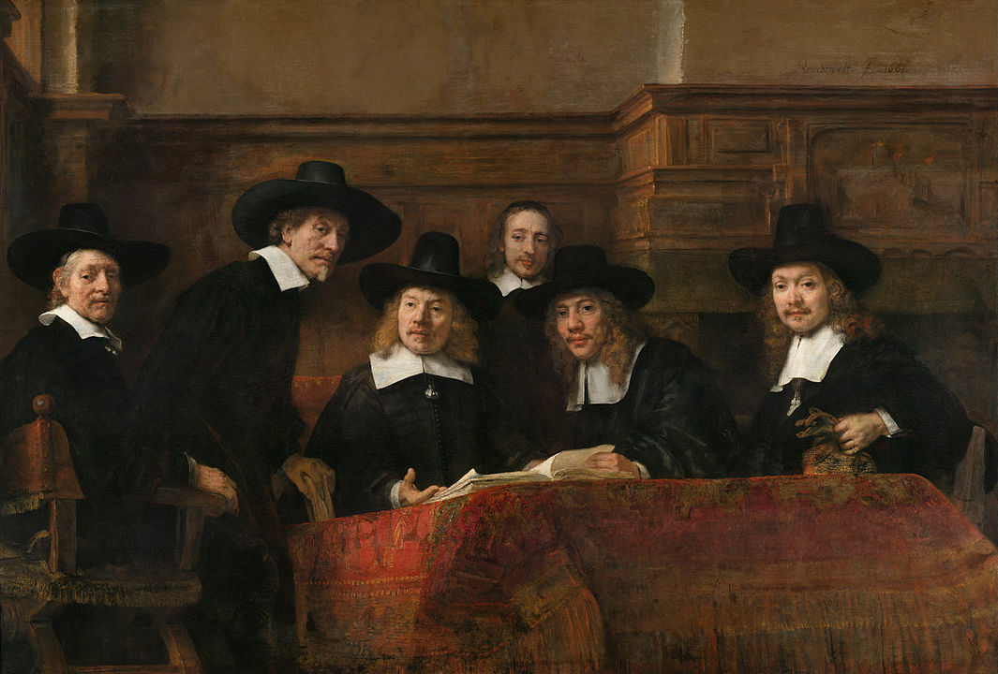
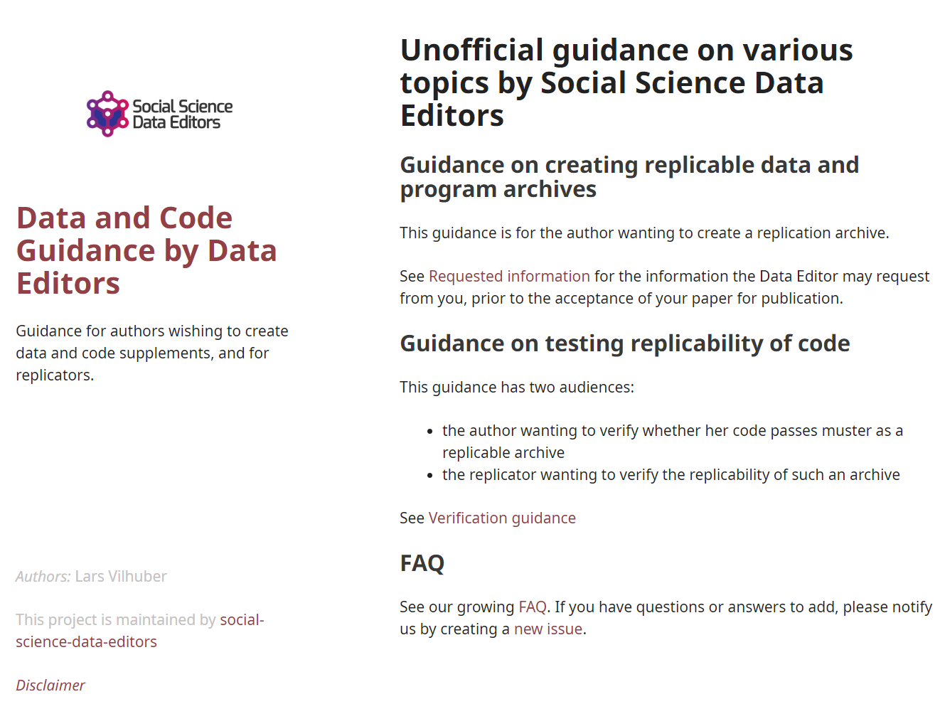
Social science “guild”
https:// social-science -data-editors. github.io/ guidance/

Slide 83
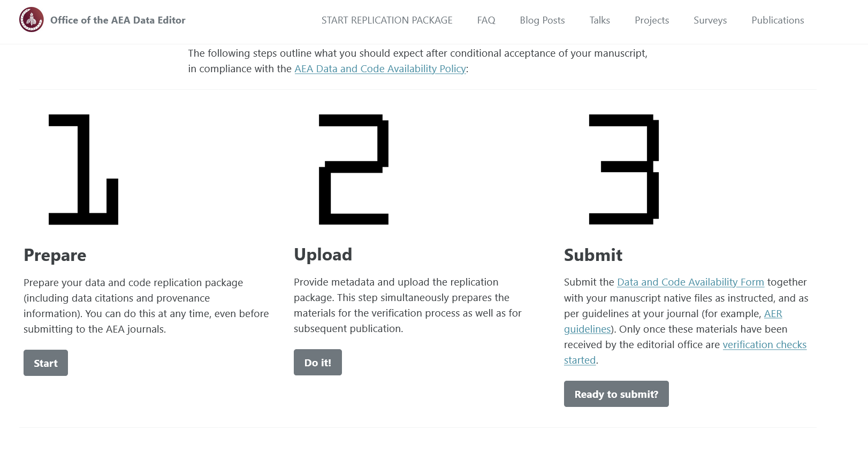

Some resources
https://social-science-data-editors.github.io/guidance/
template README
discussion of licensing
data citation guidance
https://aeadataeditor.github.io/

Slide 84
Thank you!

Slide 86
Extra slides

Slide 87
Example of data provenance

Slide 88
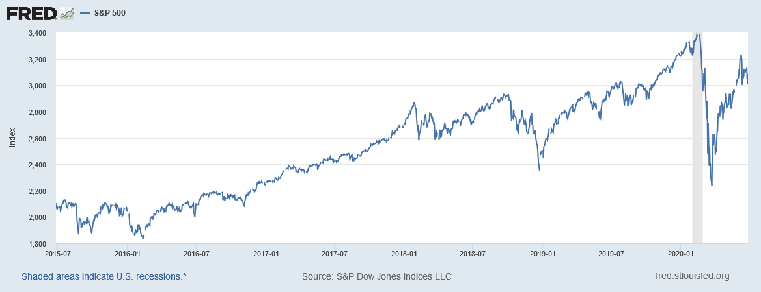
“It’s a file called stockmarket.xlsx”
2101.49
2057.64
2063.11
2077.42
2076.78
0
2068.76
2081.34
2046.68
2051.31
2076.62
2099.60
2108.95
2107.40
2124.29
2126.64
2128.28
2119.21
2114.15
2102.15
2079.65
2067.64
2093.25
2108.57
2108.63
2103.84

Slide 89
“It’s a file called SP500.xlsx”
SP500 | S&P 500, Index, Daily, Not Seasonally Adjusted
Frequency: Daily, Close
observation_date | SP500
2015-06-26 | 2101.49
2015-06-29 | 2057.64
2015-06-30 | 2063.11
2015-07-01 | 2077.42
2015-07-02 | 2076.78
2015-07-03 | 0
2015-07-06 | 2068.76
2015-07-07 | 2081.34
2015-07-08 | 2046.68
2015-07-09 | 2051.31
2015-07-10 | 2076.62
2015-07-13 | 2099.60
2015-07-14 | 2108.95
2015-07-15 | 2107.40
2015-07-16 | 2124.29
2015-07-17 | 2126.64
2015-07-20 | 2128.28

Slide 90
“It’s a file called SP500.xlsx, downloaded from FRED.”
SP500 | S&P 500, Index, Daily, Not Seasonally Adjusted
Frequency: Daily, Close
observation_date | SP500
2015-06-26 | 2101.49
2015-06-29 | 2057.64
2015-06-30 | 2063.11
2015-07-01 | 2077.42
2015-07-02 | 2076.78
2015-07-03 | 0
2015-07-06 | 2068.76
2015-07-07 | 2081.34
2015-07-08 | 2046.68
2015-07-09 | 2051.31
2015-07-10 | 2076.62
2015-07-13 | 2099.60
2015-07-14 | 2108.95
2015-07-15 | 2107.40
2015-07-16 | 2124.29
2015-07-17 | 2126.64
2015-07-20 | 2128.28

Slide 91
“It’s a file called SP500.xlsx, downloaded from FRED.”
S&P Dow Jones Indices LLC. 2020. “S&P 500 [SP500] [dataset]”, retrieved from FRED, Federal Reserve Bank of St. Louis; https://fred.stlouisfed.org/series/SP500, June 26, 2020.
SP500 | S&P 500, Index, Daily, Not Seasonally Adjusted
Frequency: Daily, Close
observation_date | SP500
2015-06-26 | 2101.49
2015-06-29 | 2057.64
2015-06-30 | 2063.11
2015-07-01 | 2077.42
2015-07-02 | 2076.78
2015-07-03 | 0
2015-07-06 | 2068.76
2015-07-07 | 2081.34
2015-07-08 | 2046.68
2015-07-09 | 2051.31
2015-07-10 | 2076.62
2015-07-13 | 2099.60
2015-07-14 | 2108.95
2015-07-15 | 2107.40
2015-07-16 | 2124.29
2015-07-17 | 2126.64
2015-07-20 | 2128.28

Slide 92
“SP500.xlsx, from S&P (2020). Not provided as part of replication package because © S&P. ”
S&P Dow Jones Indices LLC. 2020. “S&P 500 [SP500] [dataset]”, retrieved from FRED, Federal Reserve Bank of St. Louis; https://fred.stlouisfed.org/series/SP500, June 26, 2020.
SP500 | S&P 500, Index, Daily, Not Seasonally Adjusted
Frequency: Daily, Close
observation_date | SP500
2015-06-26 | 2101.49
2015-06-29 | 2057.64
2015-06-30 | 2063.11
2015-07-01 | 2077.42
2015-07-02 | 2076.78
2015-07-03 | 0
2015-07-06 | 2068.76
2015-07-07 | 2081.34
2015-07-08 | 2046.68
2015-07-09 | 2051.31
2015-07-10 | 2076.62
2015-07-13 | 2099.60
2015-07-14 | 2108.95
2015-07-15 | 2107.40
2015-07-16 | 2124.29
2015-07-17 | 2126.64
2015-07-20 | 2128.28

Slide 93
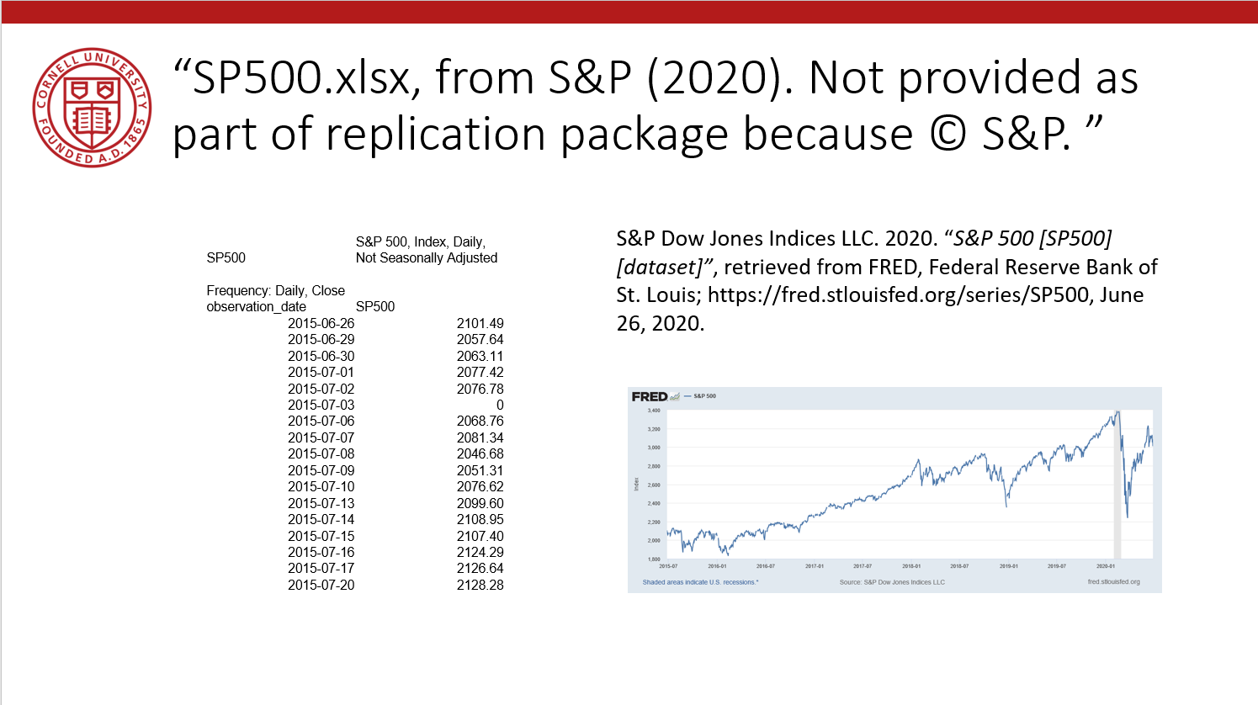
Data Availability Statements
Describes data file, where to get it, how to get it, and any conditions of obtaining it

Slide 94
Data Citations

Slide 95
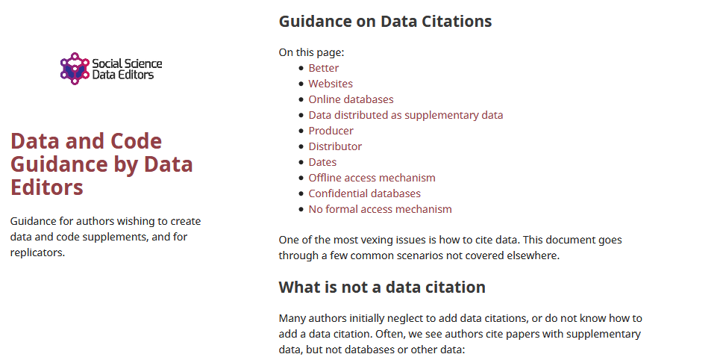
Data citations
Creating specific guidance in the absence of strong discipline-specific guidance
https://social-science-data-editors.github.io/guidance/addtl-data-citation-guidance.html

Slide 96
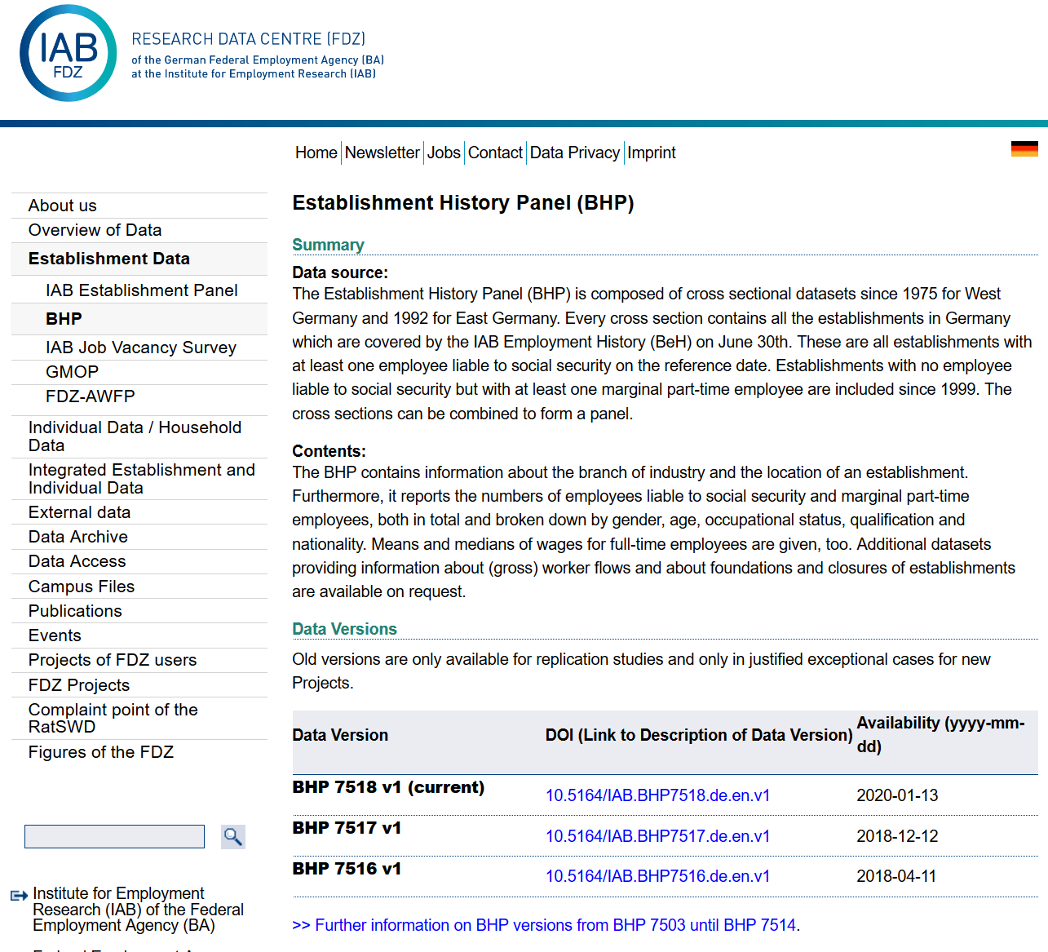
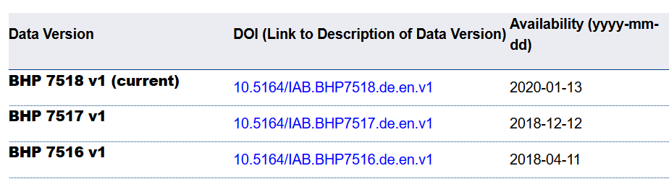
Example 4: German Restricted-access

Slide 97
Data Citation
Attributes the file to the proper source

Slide 98
Element of a (data) citation
ICPSR notes that a citation should include the following items:
Author
Title
Distributor
Date
Version
Persistent identifier
Suggested Citation:
S&P Dow Jones Indices LLC, S&P 500 [SP500], retrieved from FRED, Federal Reserve Bank of St. Louis; https://fred.stlouisfed.org/series/SP500, June 26, 2020.

Slide 99
Element of a (data) citation
ICPSR notes that a citation should include the following items:
Author
Title
Distributor
Date
Version
Persistent identifier
Constructed Citation:
Institute for Employment Research (IAB), Establishment History Panel 1975-2018. Accessed via the Research Data Centre (FDZ) of the German Federal Employment Agency DOI: 10.5164/IAB.BHP7518.de.en.v1 June 26, 2020.

Slide 100
Element of a (data) citation
ICPSR notes that a citation should include the following items:
Author
Title
Distributor
Date
Version
Persistent identifier
Constructed Citation:
US Census Bureau, Longitudinal Business Database (LBD) 1975-2018. Last accessed via the Federal Statistical Research Data Centre (FSRDC) June 26, 2020.

Slide 101
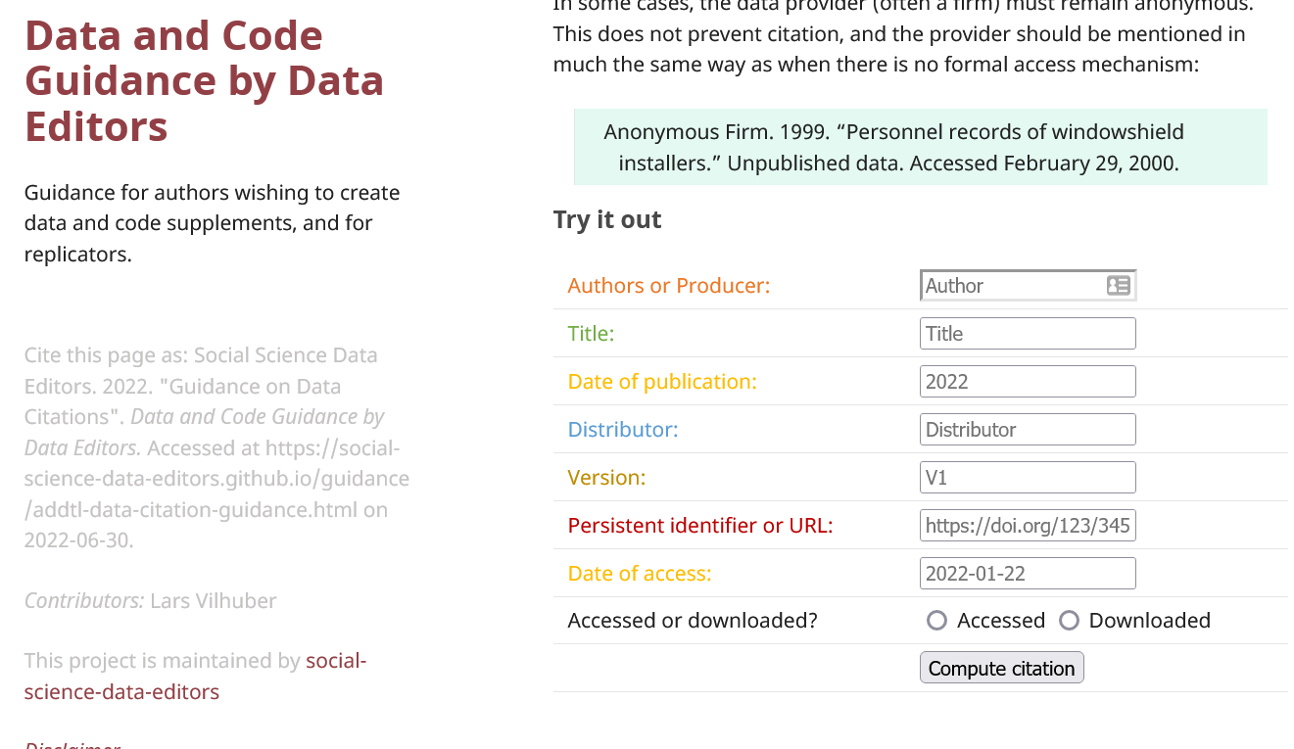
Try it out yourself
Construct an (approximate) data citation
https://social-science-data-editors.github.io/guidance/addtl-data-citation-guidance.html#try-it-out

Slide 102
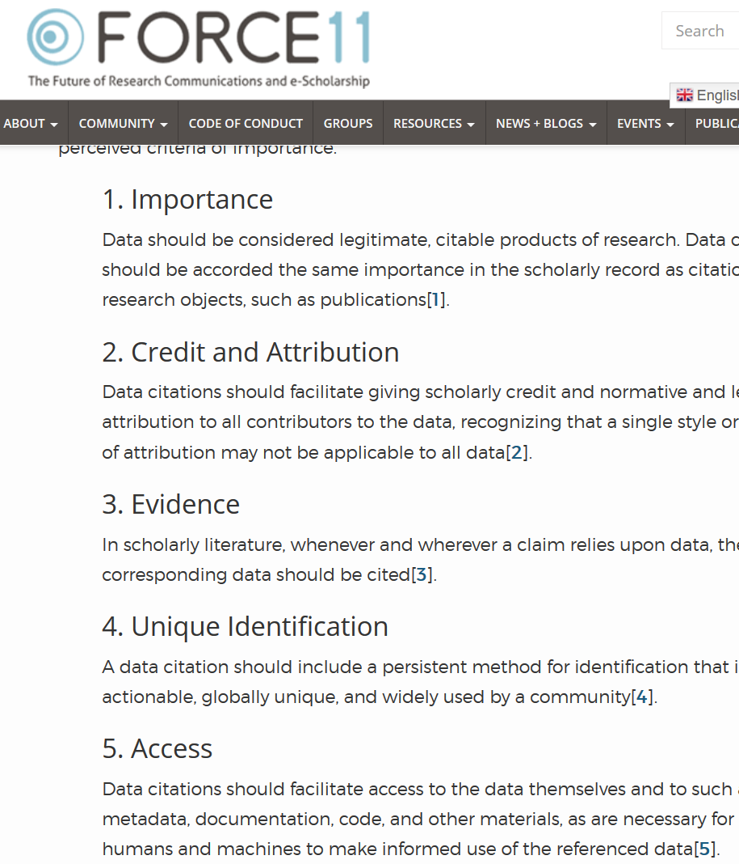

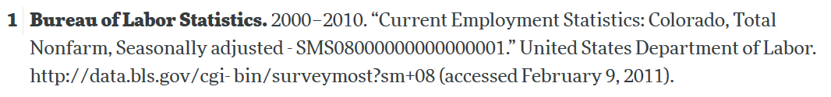
Starts with Data Citations
Data Citation Principles
Image of a standard data citation
Data Citation Synthesis Group: Joint Declaration of Data Citation Principles. Martone M. (ed.) San Diego CA: FORCE11; 2014 [https://www.force11.org/group/joint-declaration-data-citation-principles-final].

Slide 103
Rights to use data
You browsed a website
You purchased the data
You signed a data use agreement
You created the data (lab experiment)
You had survey respondents consent to use (IRB approval!)

Slide 104
Rights to distribute the data
If you created the data, you decide.
If you got it from somewhere else:
READ THE TERMS OF USE / DATA USE AGREEMENT / CLICK-THROUGH / ETC.

Slide 105
Data: Citations, Access, Rights
Any data can be cited – even if you can’t download it
Any data that you accessed … can have that access be described
But caution: It should be such that others can also repeat the access!
Just because you “have” the data does not mean you can give it to others
Also: distinguish between “sharing” and “publishing”
Know your terms of use!

Slide 106
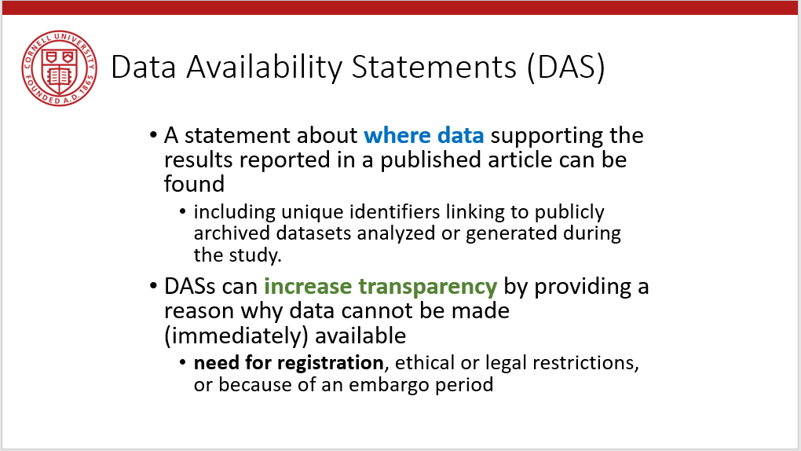
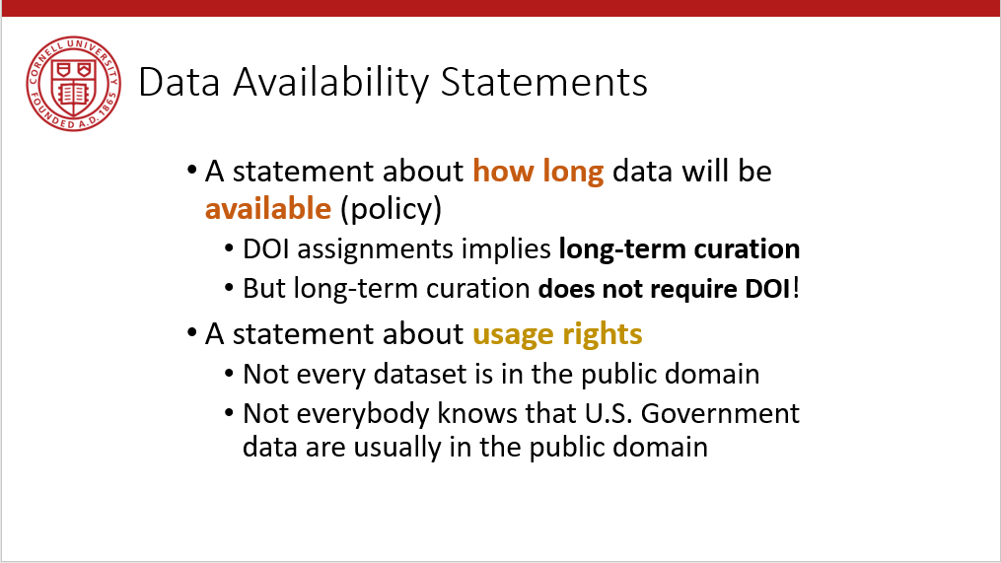
Provide data citations (in manuscript) and data availability statements (in README or appendix)

Slide 107
Solution 3: Data Citations
Cite every data source
(not only the paper that describes the source!)
(also: add them to the Social Science Data Editors’ template README)

